Slide 1

Pacific cod explorations for 2026

Slide 2
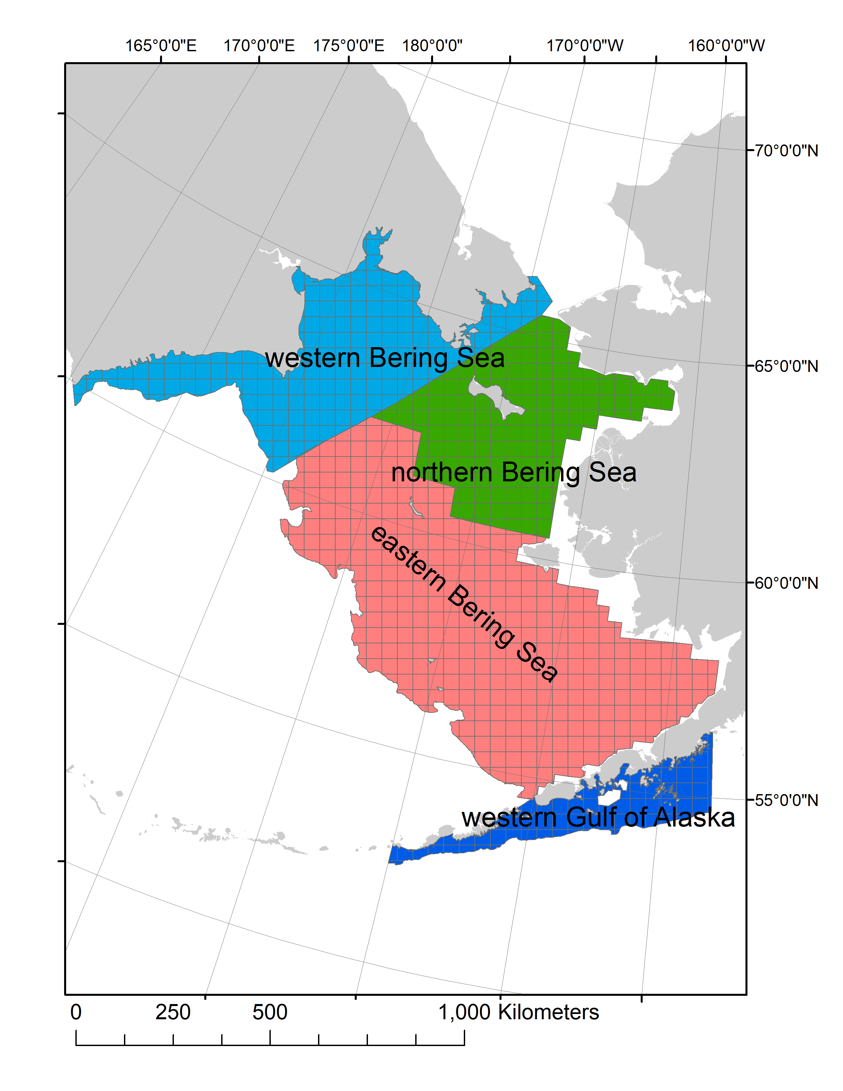
What about the western Bering Sea?
Tagging data show consistent Pacific cod movement among the eastern, northern, and western Bering Sea.
Genetic specimen of the western Bering Sea group among the eastern Bering Sea samples.

Slide 3
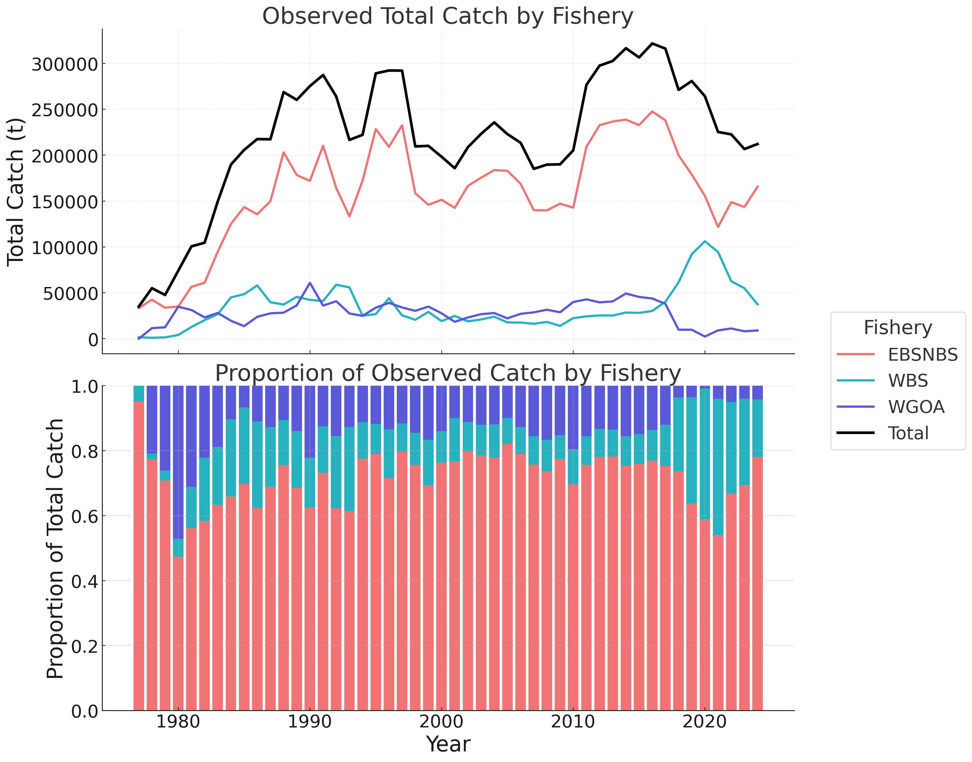
Western Bering Sea catch increase
Western Bering Sea Pacific cod catch has increased substantially in the last 5 years.
From 1990-2016 WBS catch average ~27,600t (13.1% of the total Bering Sea catch)
For 2017-2024 WBS catch averaged 68,700 t (28.9% of the total Bering Sea catch) with a peak catch of 106,200 t in 2020

Slide 4
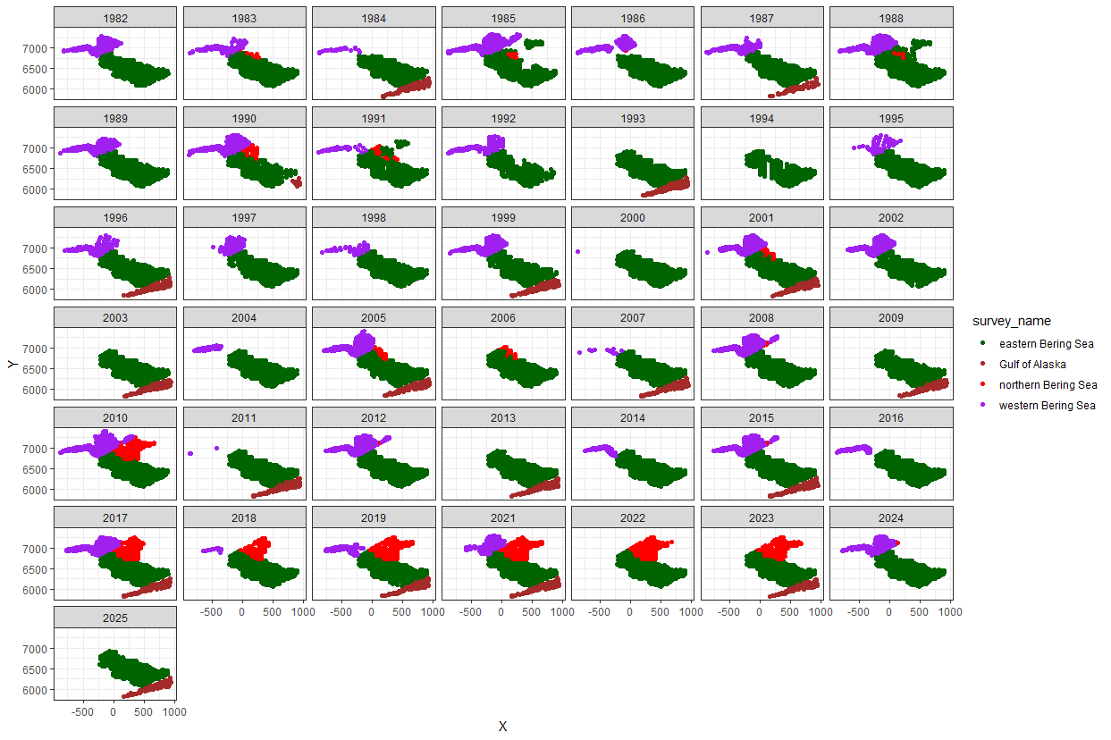
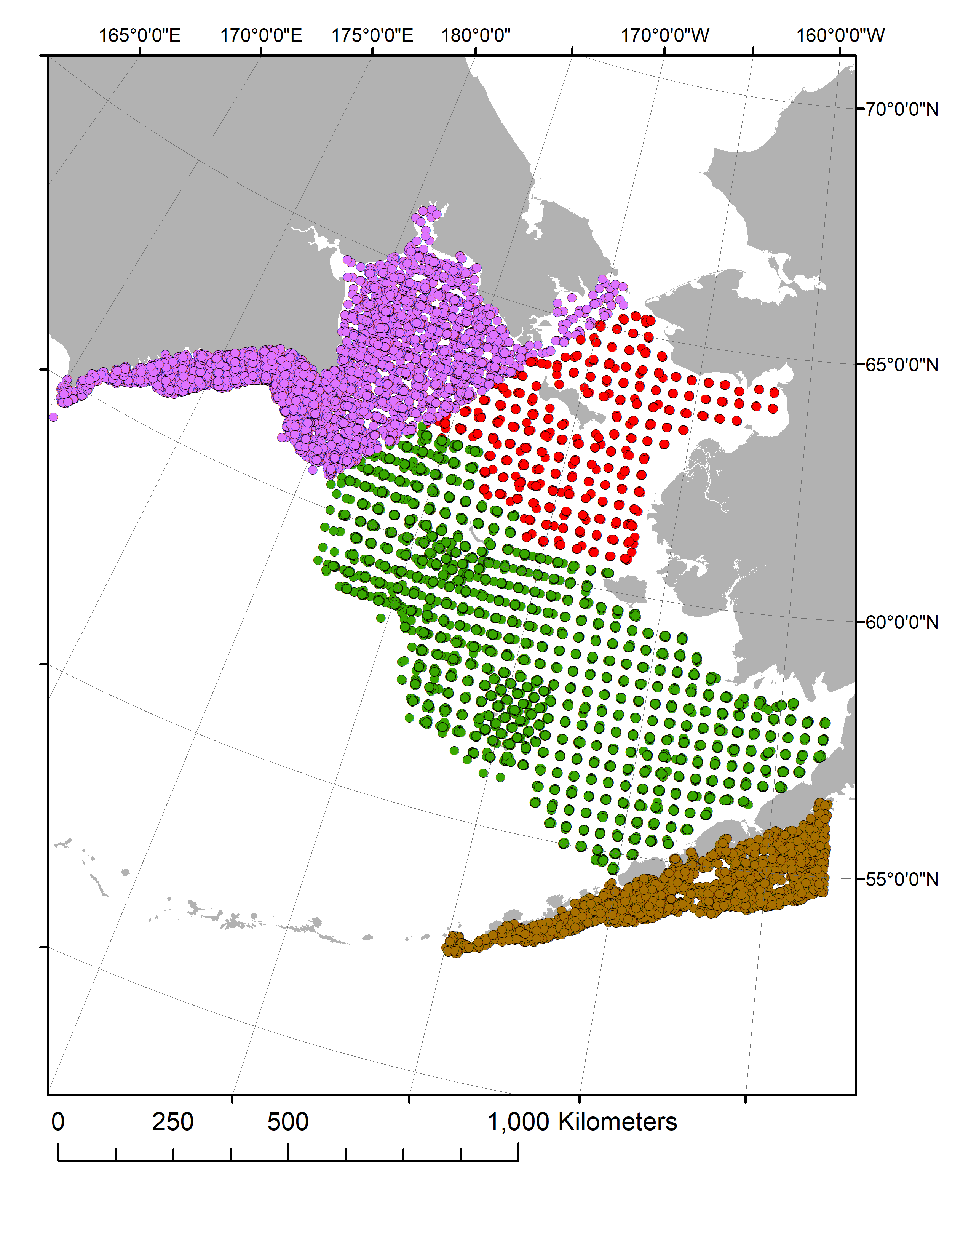
Western Bering Sea Survey Data
1982-2024
34 unique vessels

Slide 5
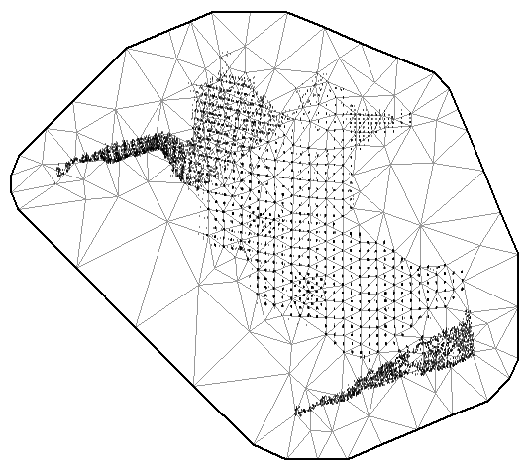
sdmTMB indices
sdmTMB was used to develop biomass indices using all available survey data
Two indices examined
W/ WBS survey data
Without WBS survey data
Tweedie distribution assumed (11% zeros)
Barrier mesh with 300 nodes
Year, nation, and splined depth by nation as fixed effects
Cold pool and survey name as spatial effects
Assumed anisotropic

Slide 6
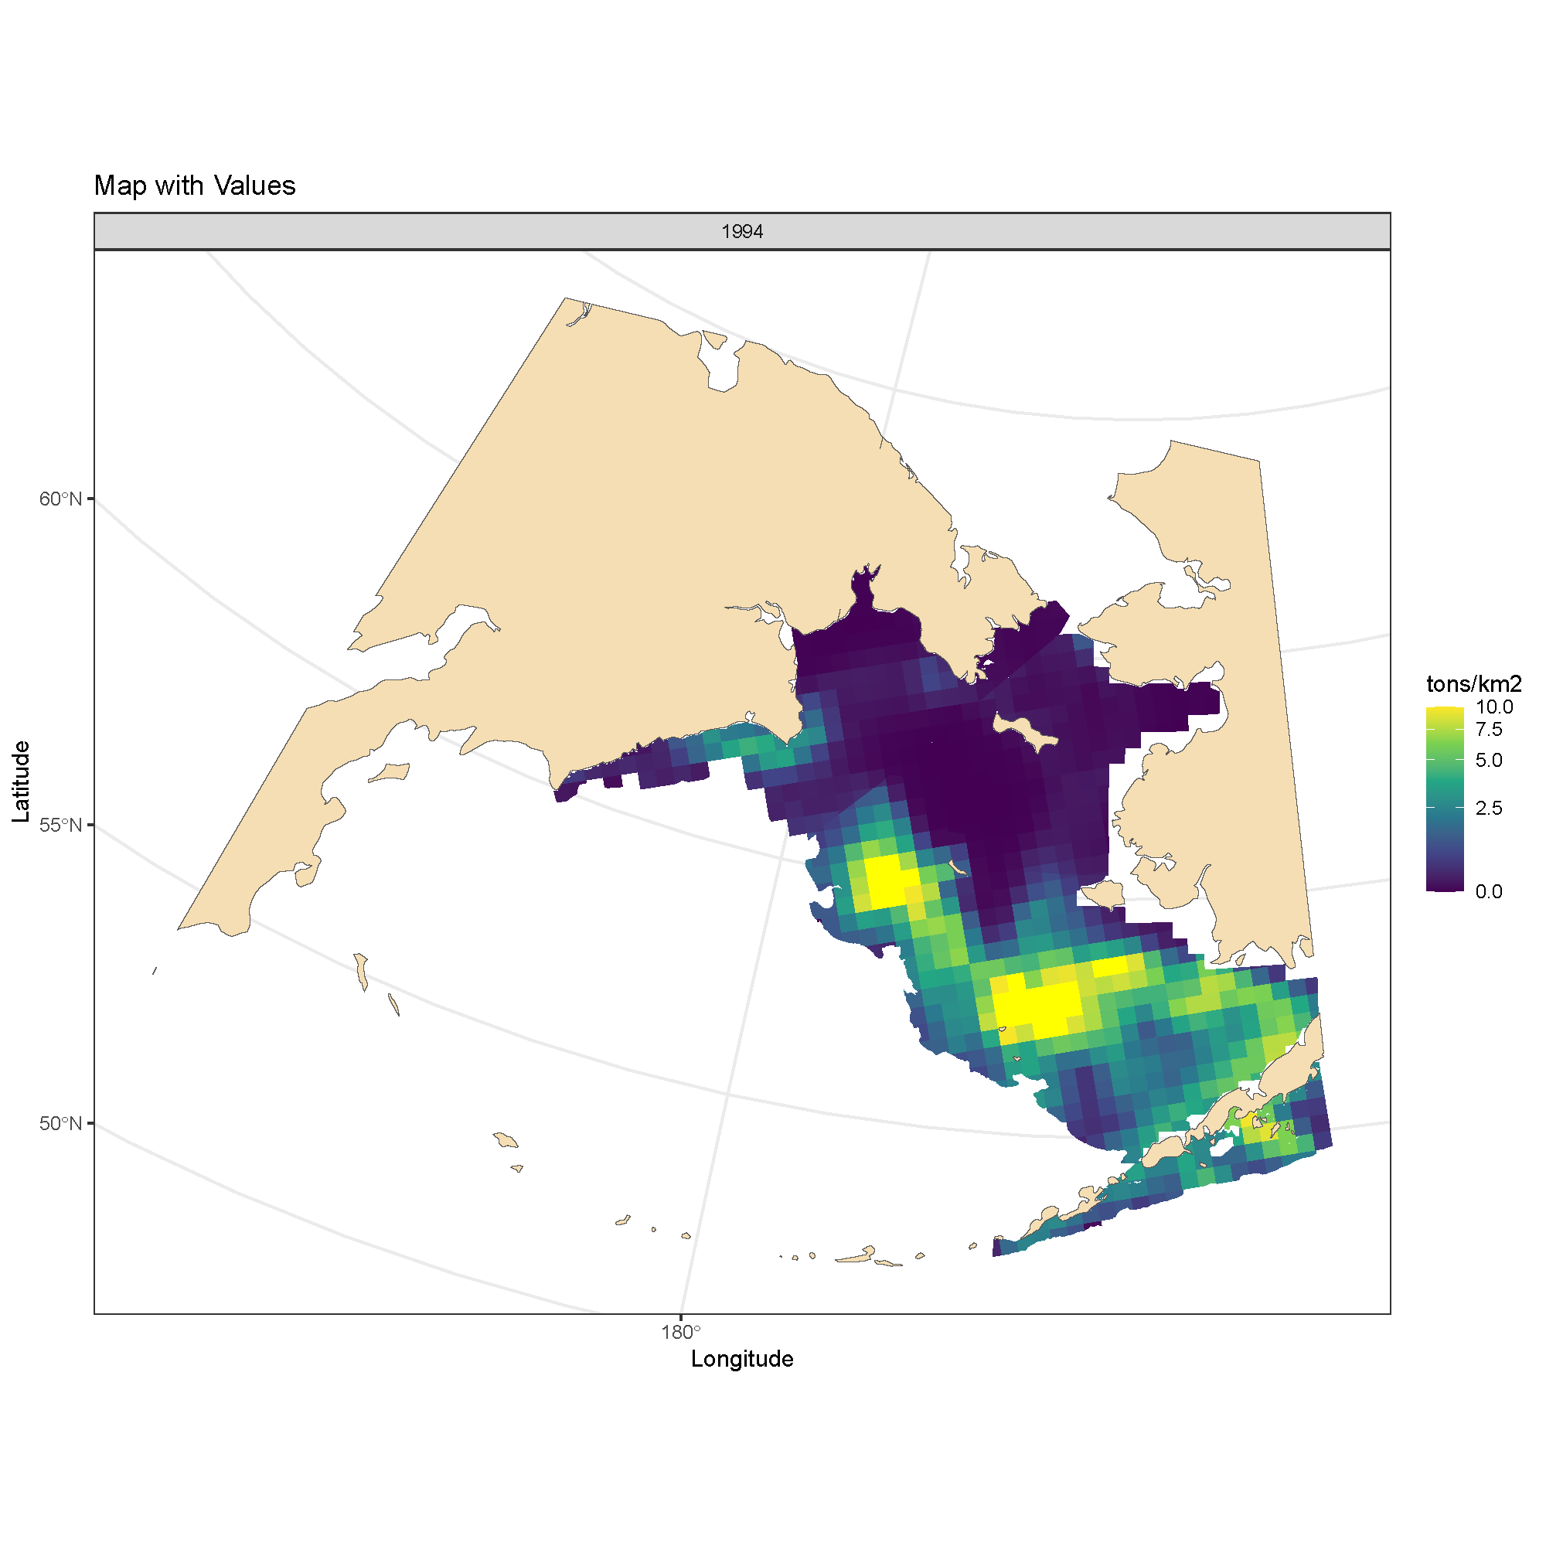
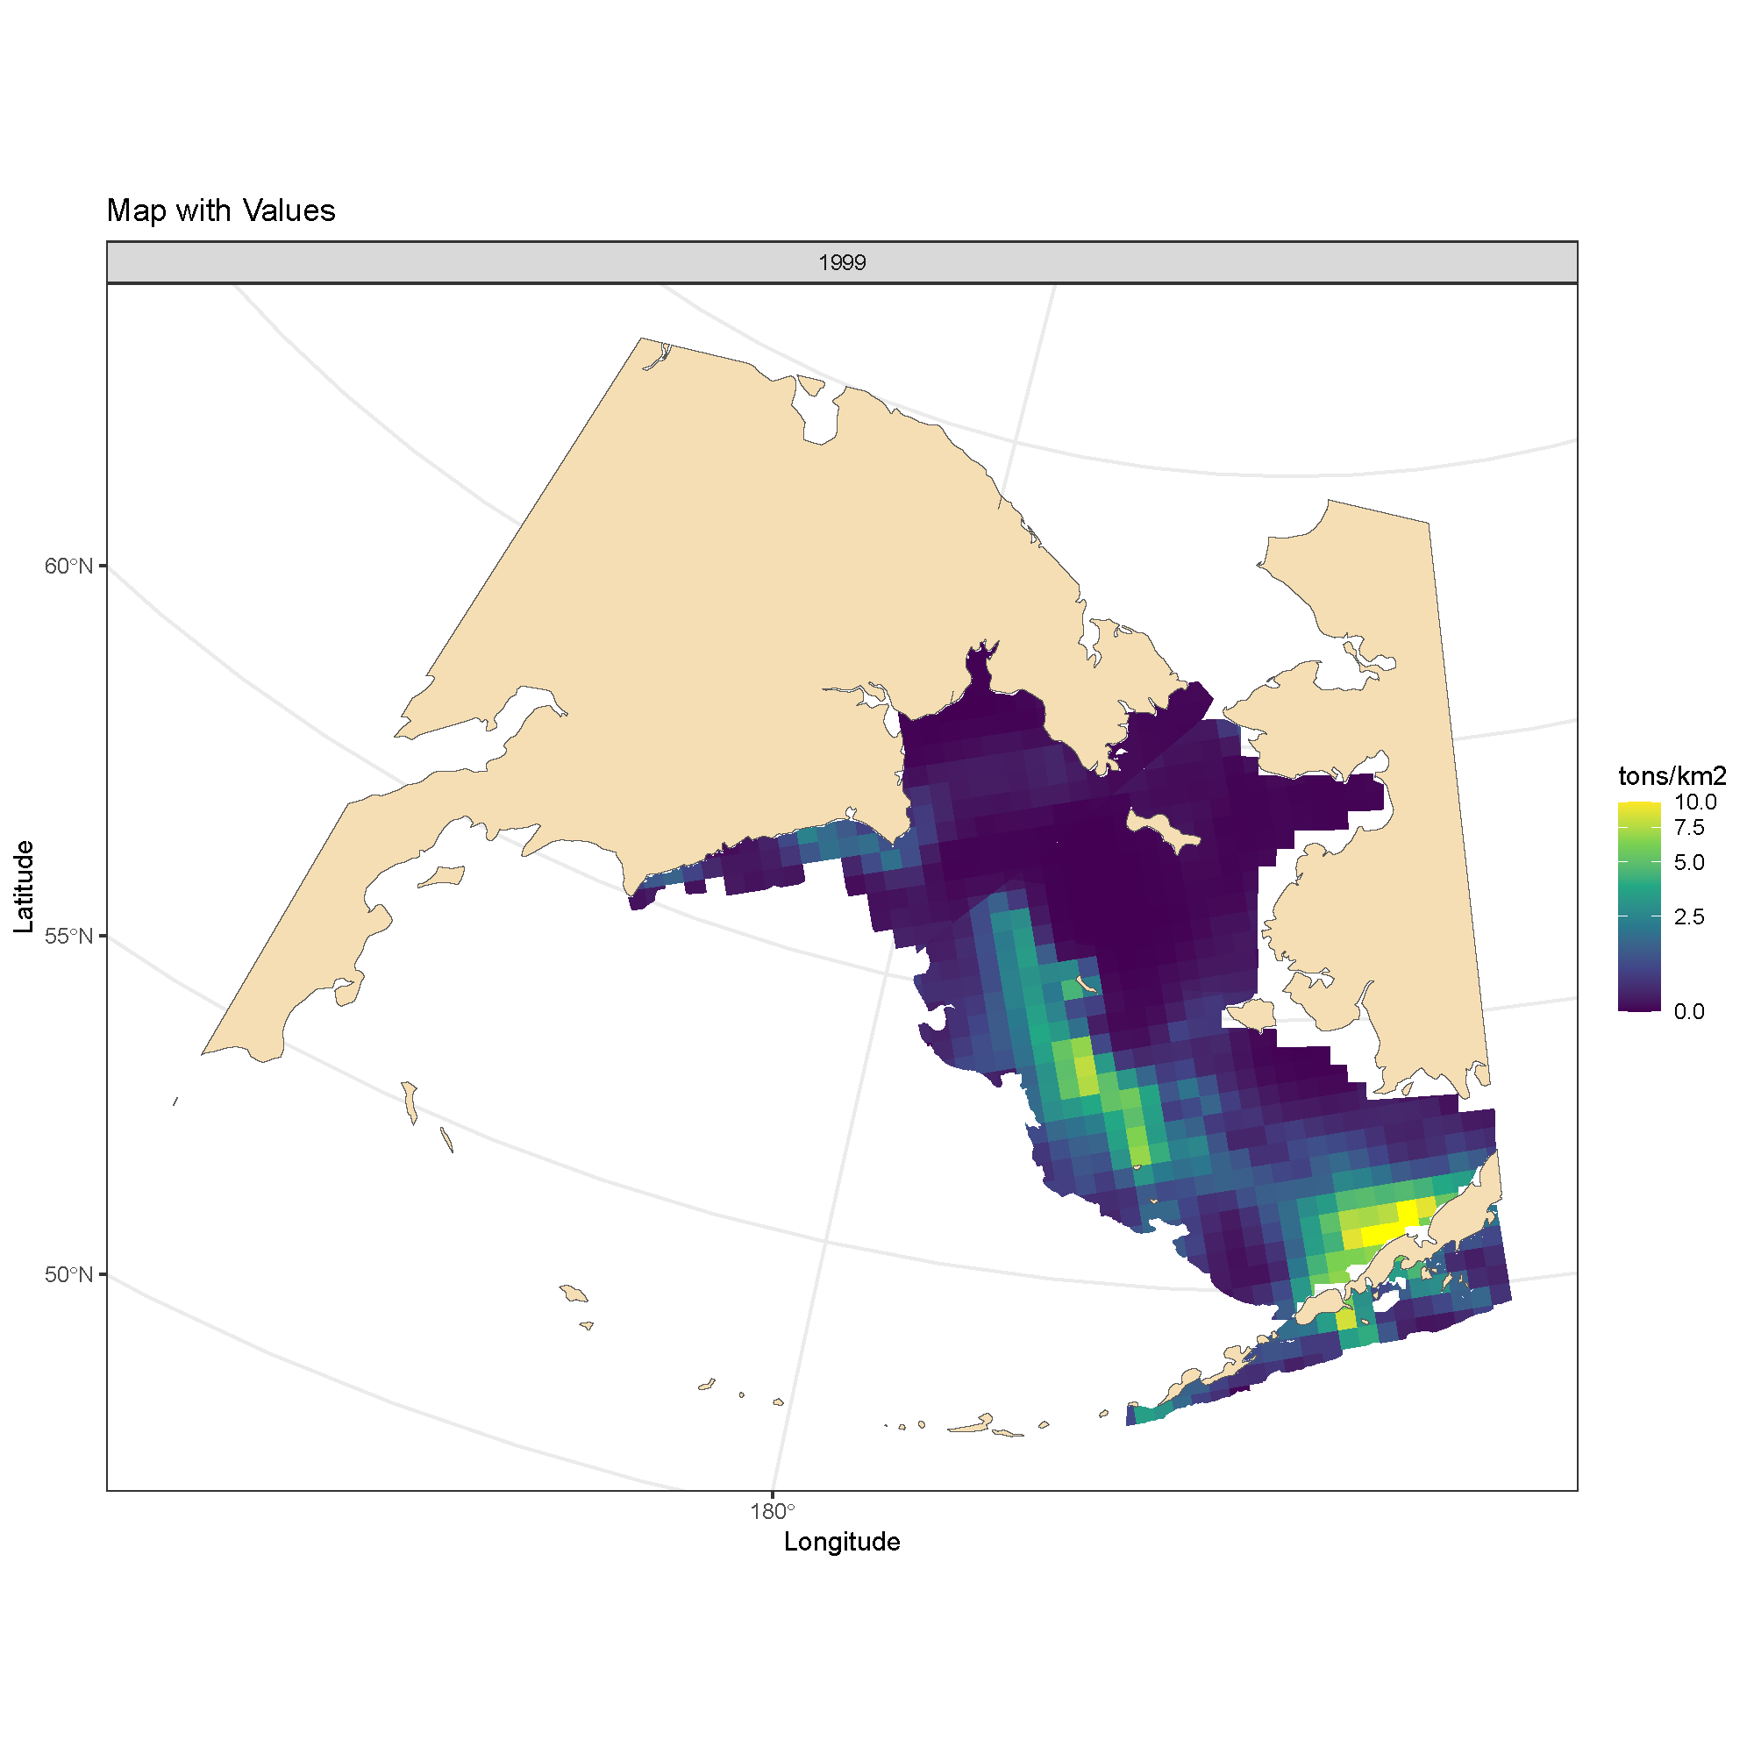
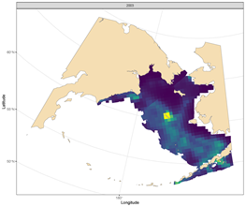
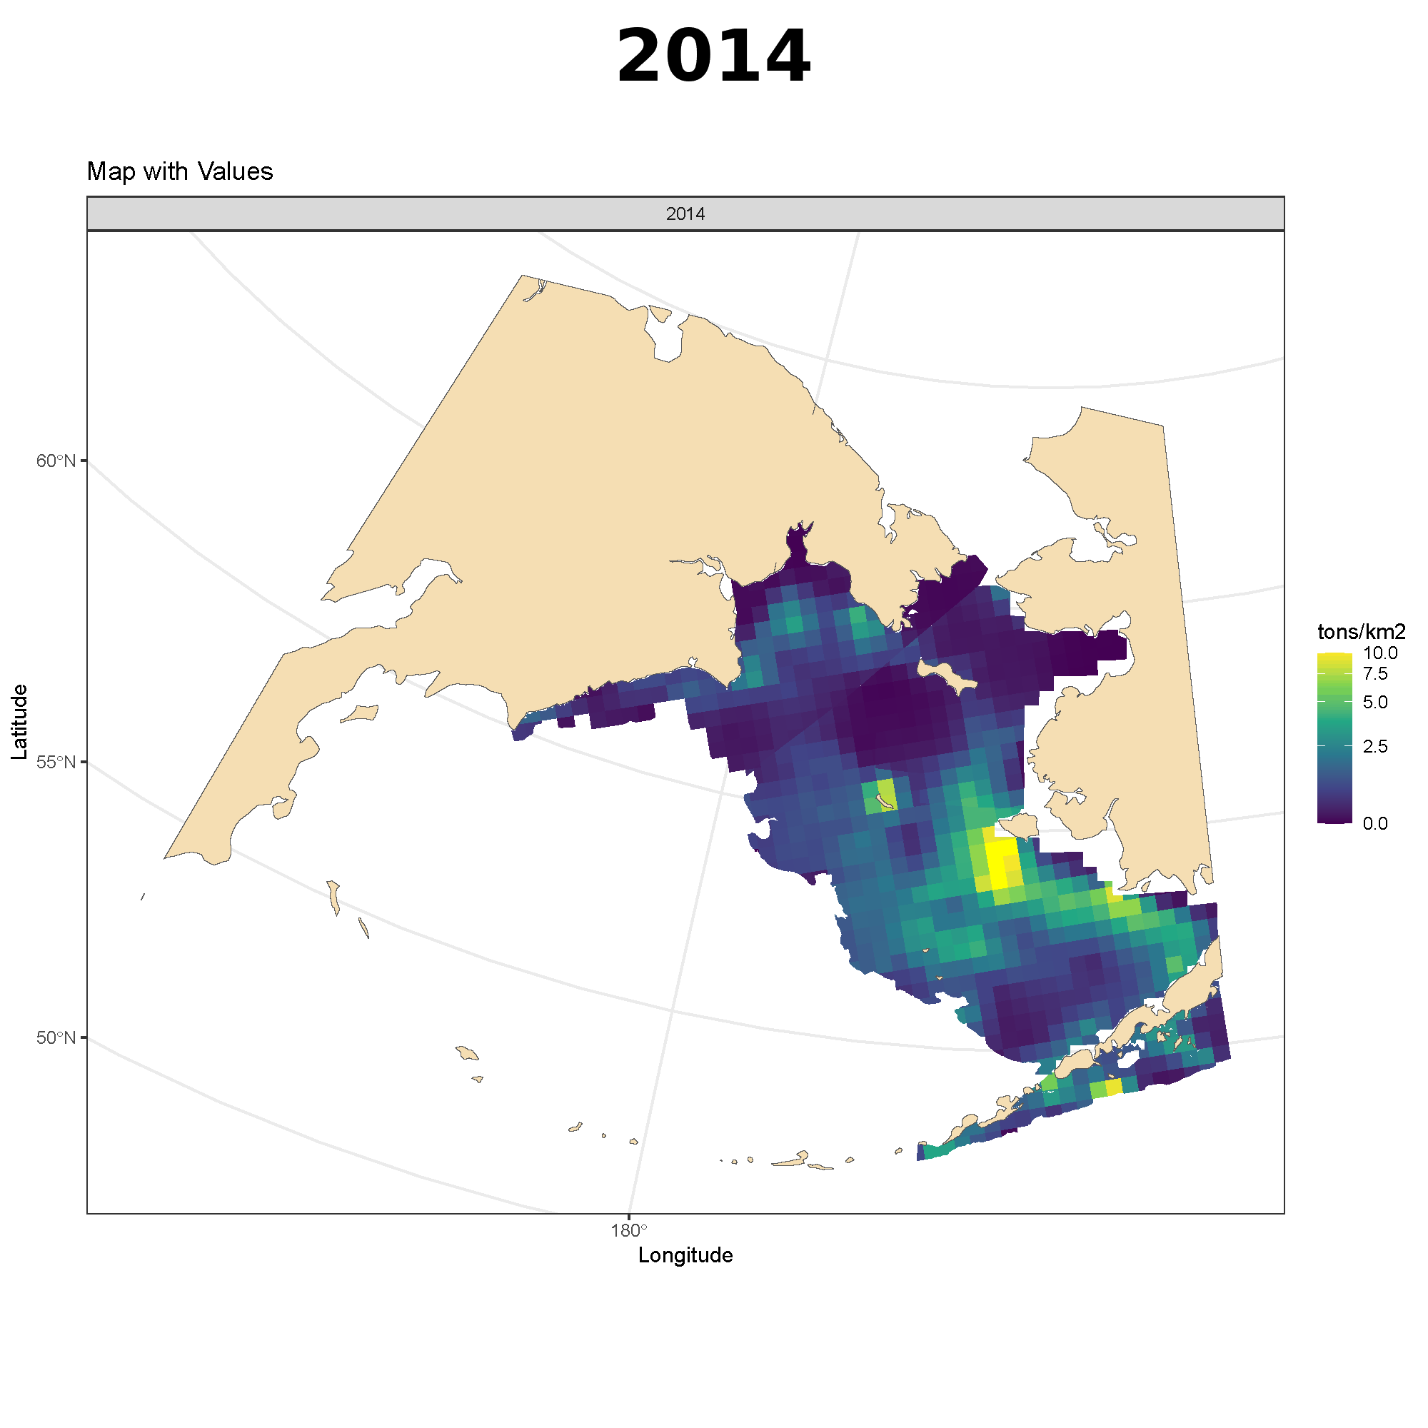
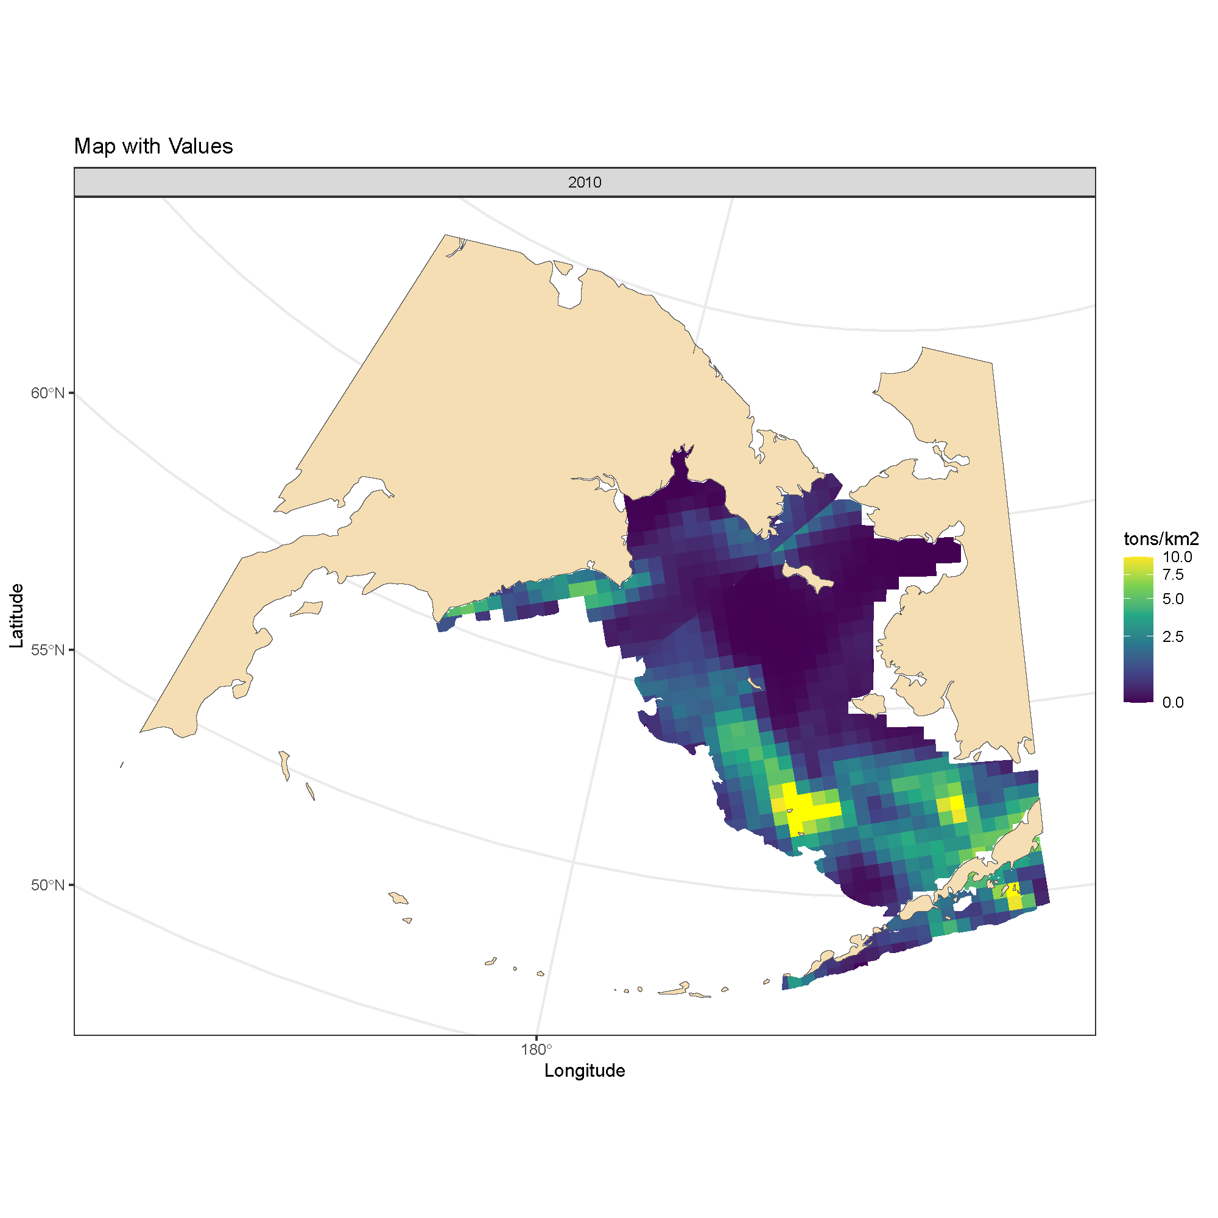
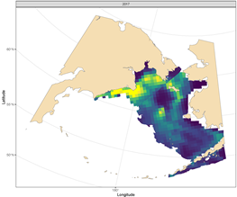
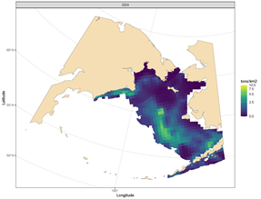
sdmTMB indices
Density plots (t/km2) of Pacific cod distribution for 1994, 1999, 2003, 2010, 2017, and 2024 from the sdmTMB projection with WBS survey data from the western Bering Sea
1994
1999
2003
2010
2017
2024

Slide 7
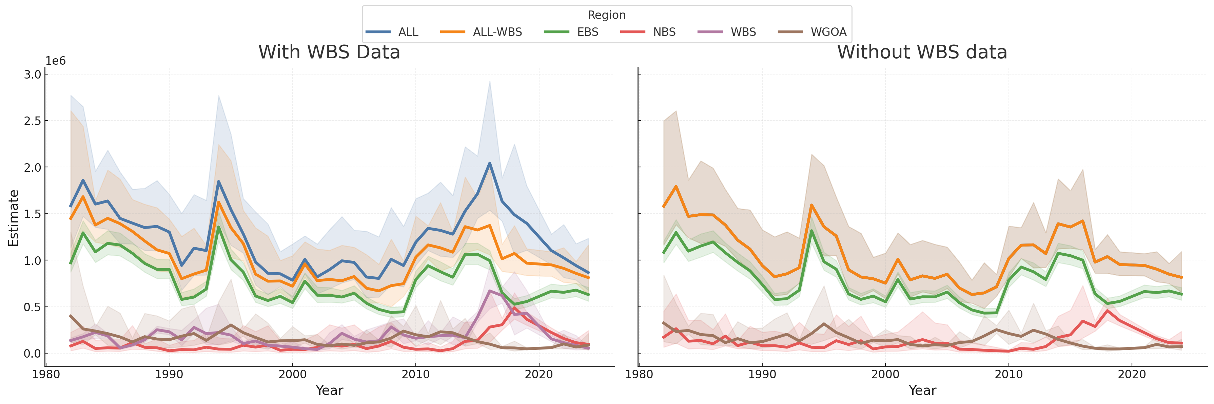
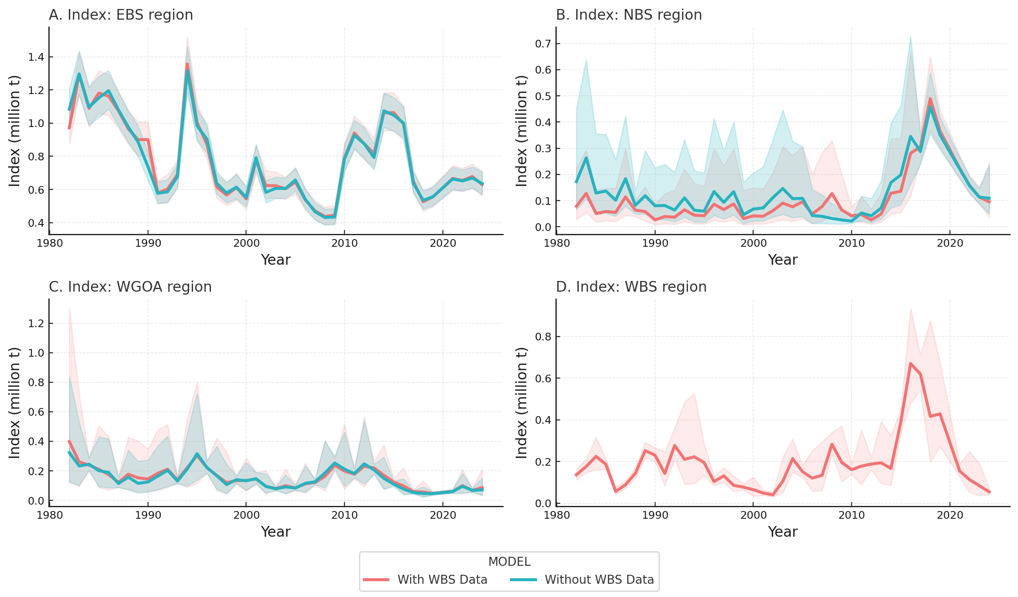
sdmTMB indices
Comparison of with and without western Bering Sea data
Very similar fits for EBS and wGOA with and without WBS data
NBS estimates in general slightly lower with WBS survey data included except for 2005-2009
Both have similar peaks and valleys
Sharp increase and fall in NBS and WBS biomass from 2014-2024

Slide 8
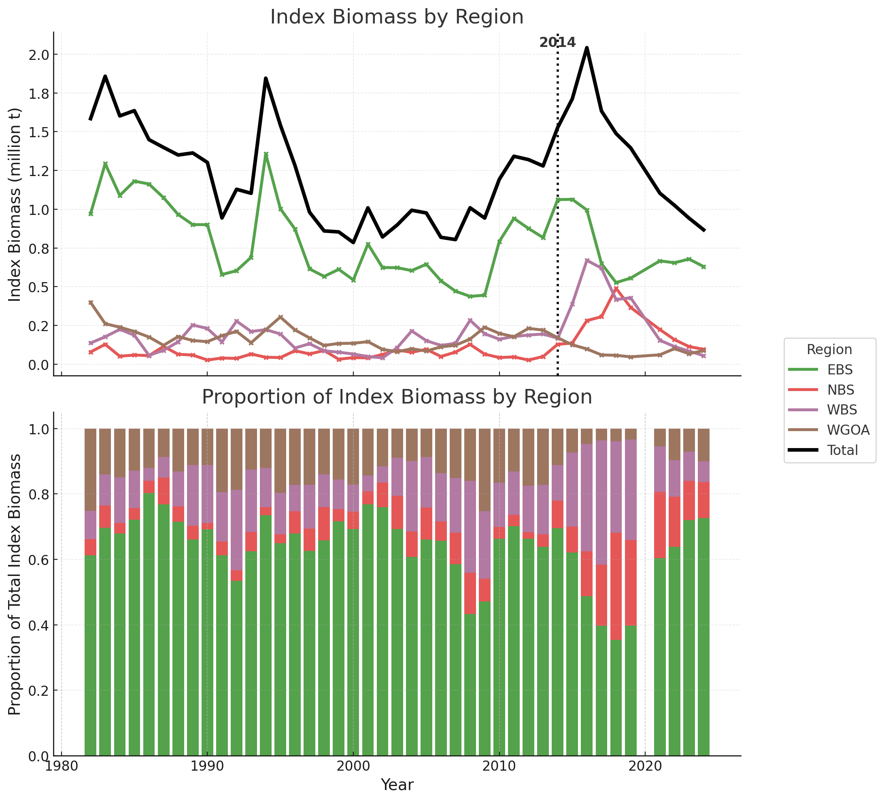
sdmTMB indices
Shift in biomass distribution to WBS and NBS post-2014
The average proportion of biomass in the WBS compared to the all areas for 1982-2014 was 13.3%
For 2015-2019 that proportion rose to 30.4%
For 2024 the WBS share of biomass has dropped to 6.3%
Although an increase in NBS biomass started prior to the WBS increase, it peaked in 2018, two years after the WBS.

Slide 9
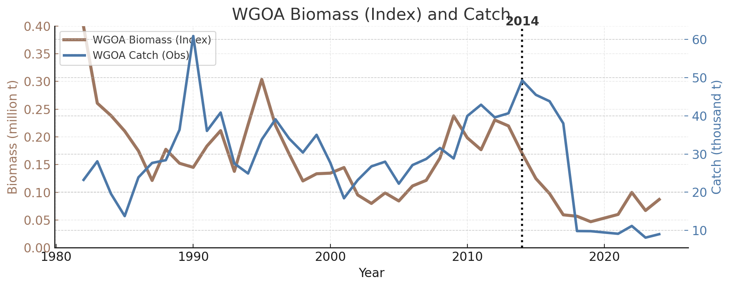
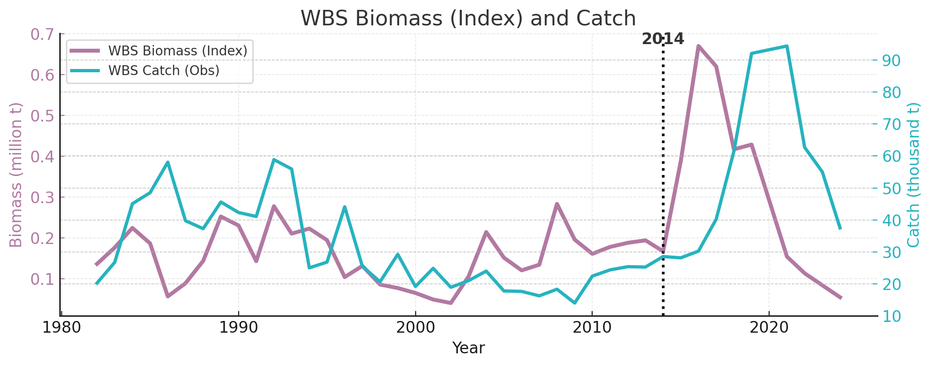
WGOA and WBS Pacific cod Biomass and Catch dynamics
WGOA catch continued to be high during the collapse, then dropped quickly.
WBS catch appears to have missed the biomass peak and were high as the stock biomass dropped

Slide 10
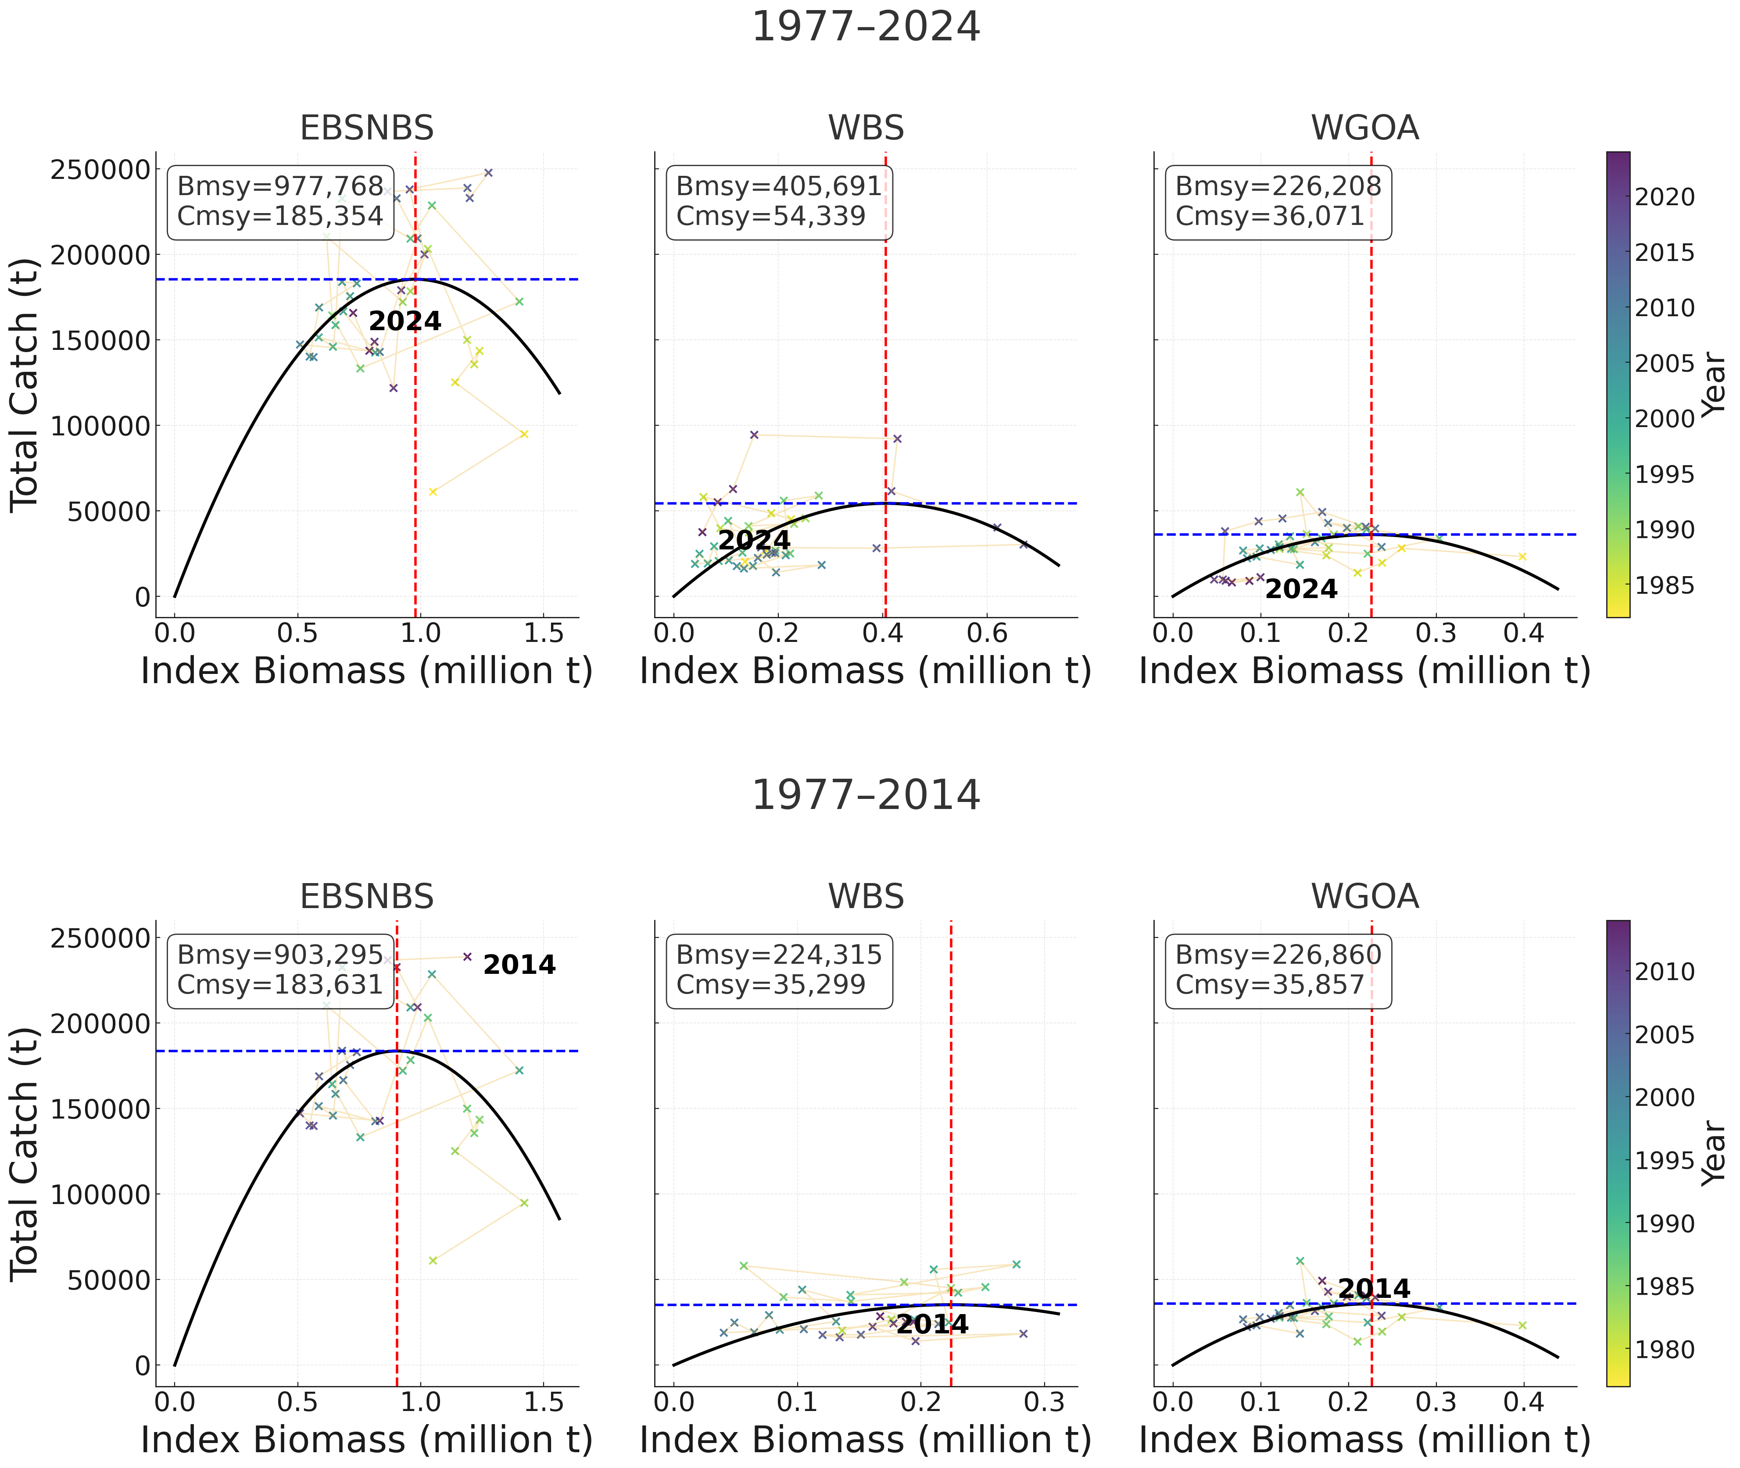
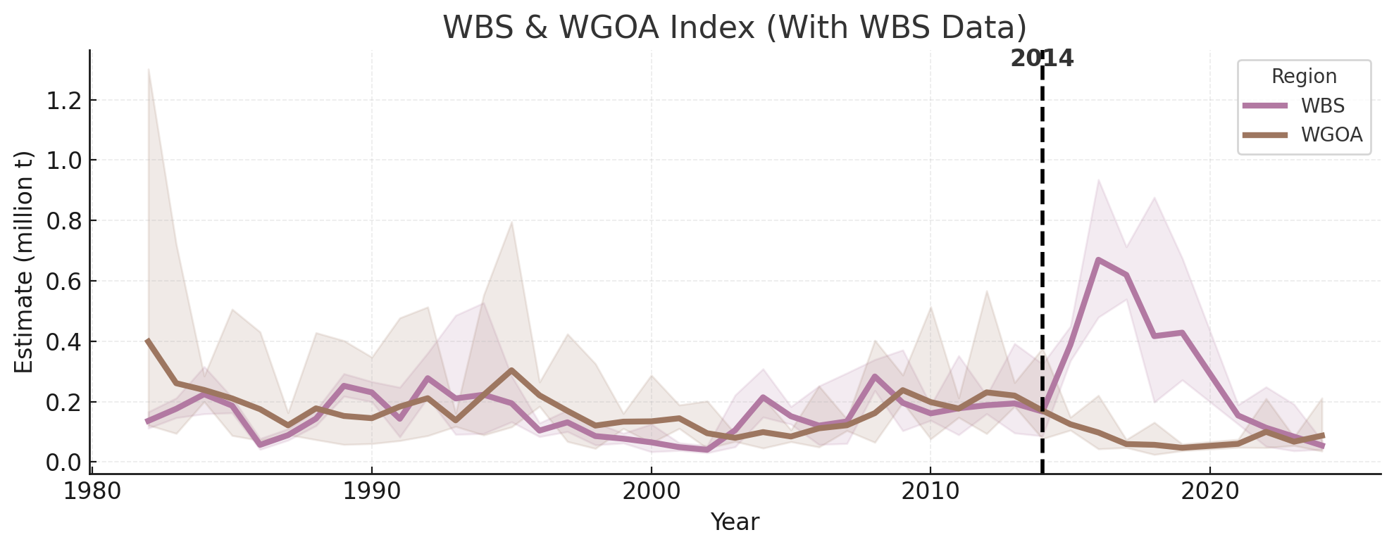
Simple Schaefer Model Fits
Shows much higher carrying capacity for eastern and northern Bering Sea compared to the other two regions
Substantial change in estimated MSY for the WBS when including 2015-2024 data.

Slide 11
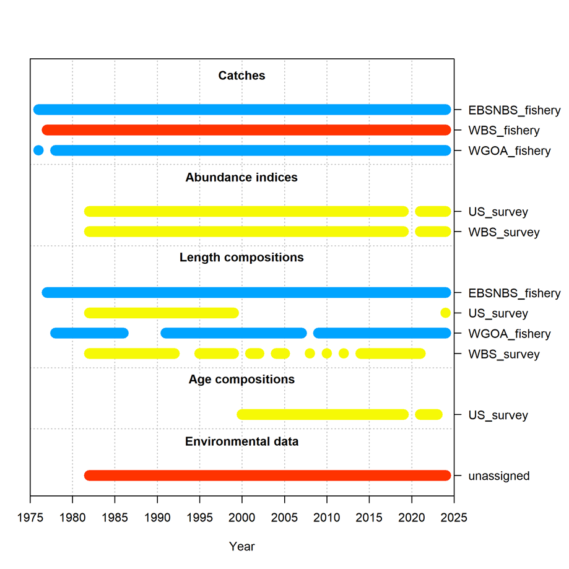
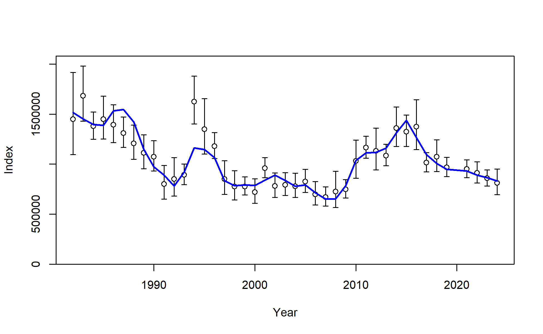
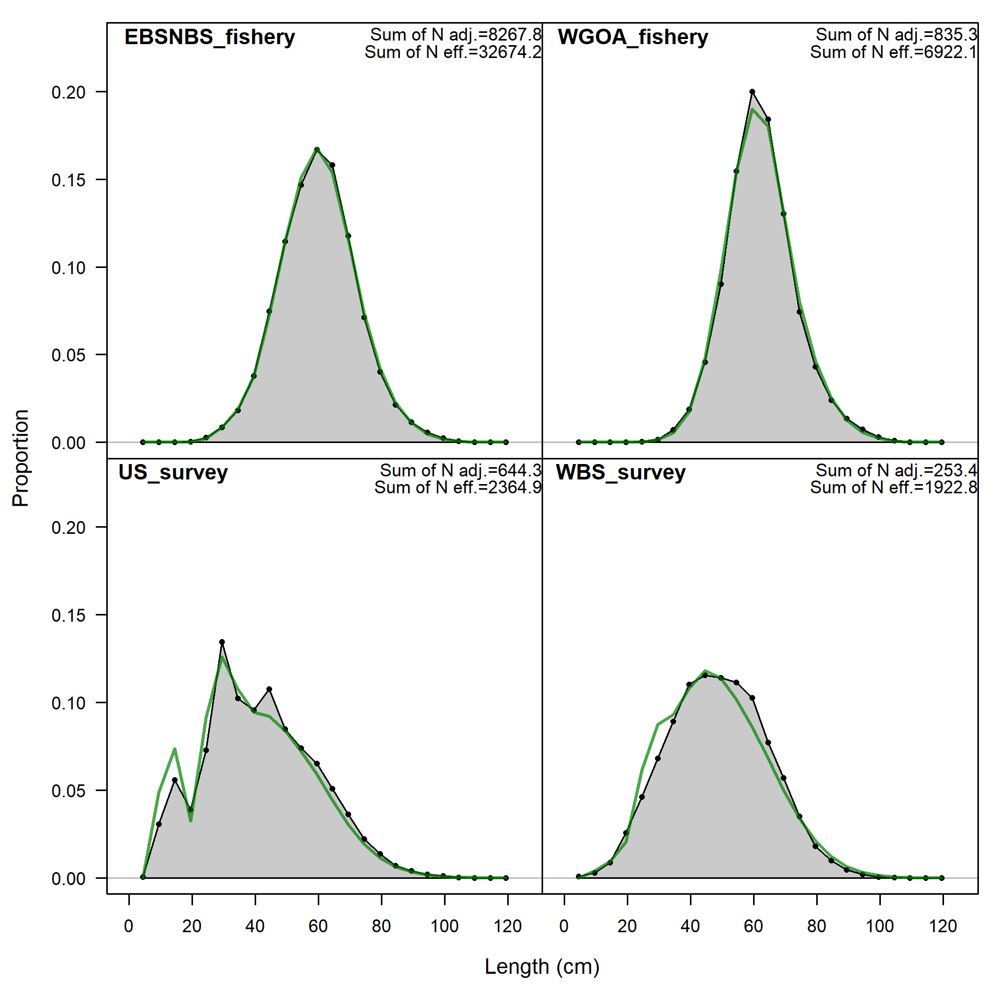
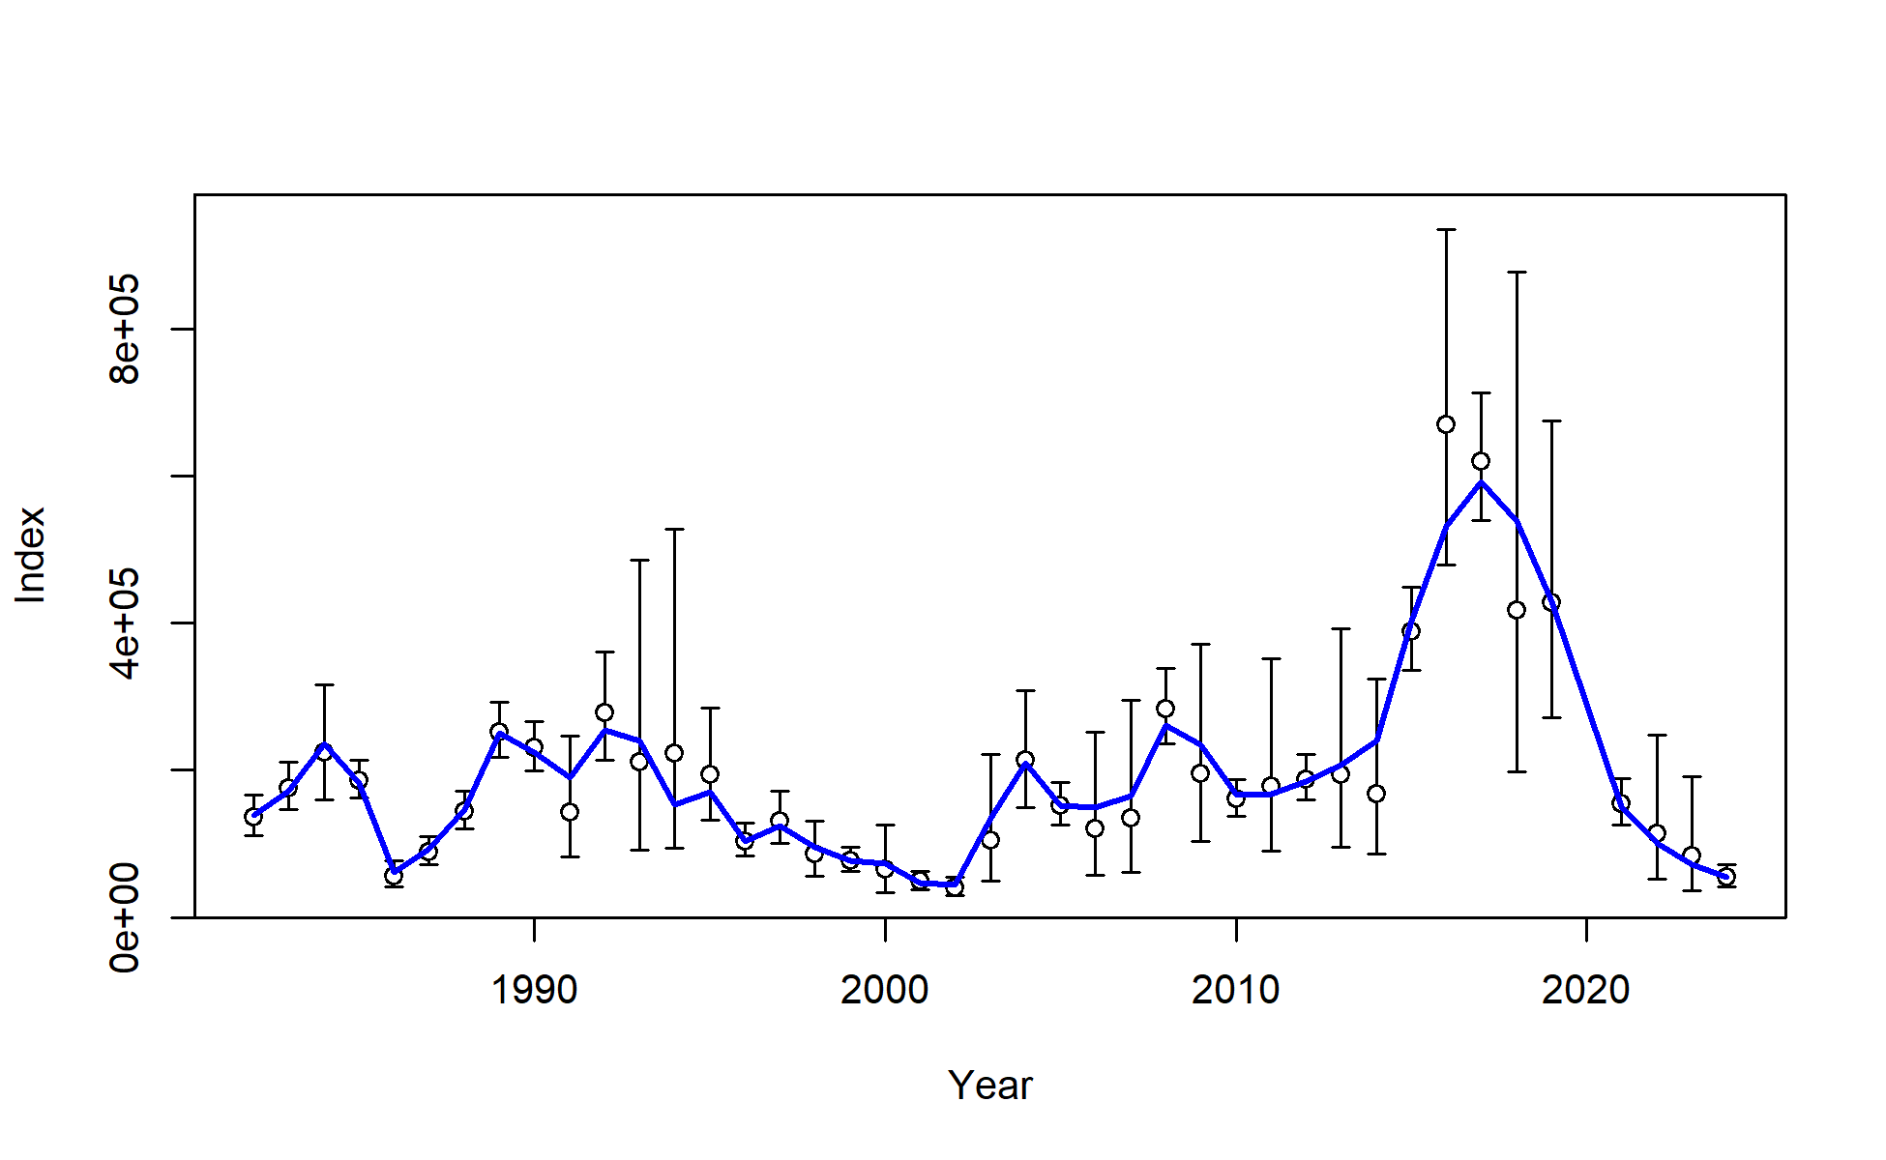
Stock Synthesis Model
Exploratory movement model
Two areas
Area 1 = EBS,NBS, and WGOA
Area 2 = WBS
Three fisheries
EBS+NBS
Western Gulf of Alaska
Western Bering Sea
sdmTMB biomass indices used
These results are preliminary and should not be considered for management purposes

Slide 12
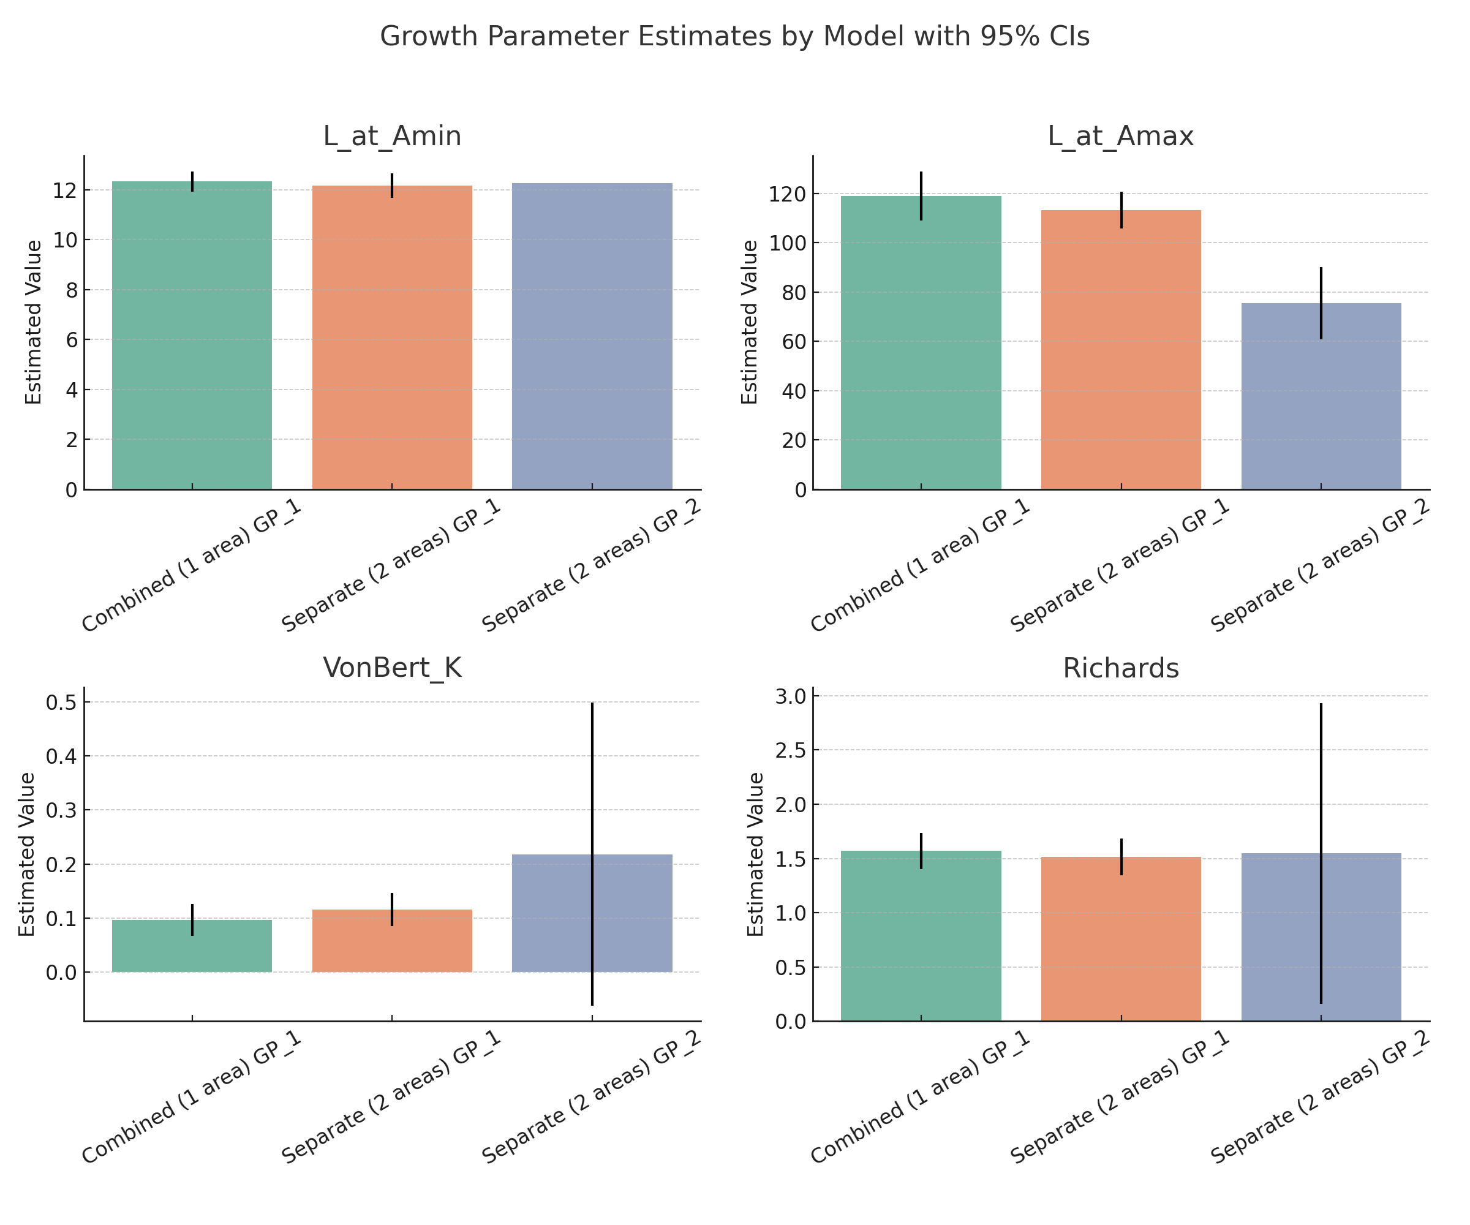
Stock Synthesis Model:
Growth
No age data available for western Bering Sea
Highly uncertain growth for WBS
Results in highly uncertain recruitment estimates
Results in highly uncertain movement rates
These results are preliminary and should not be considered for management purposes

Slide 13
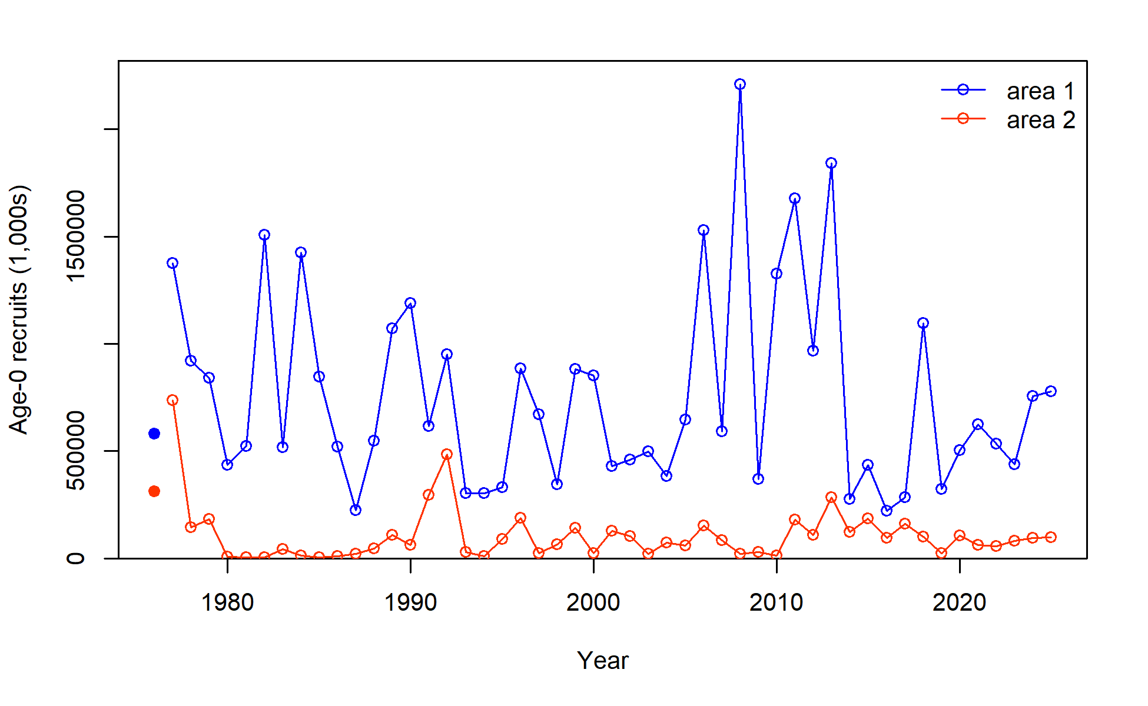
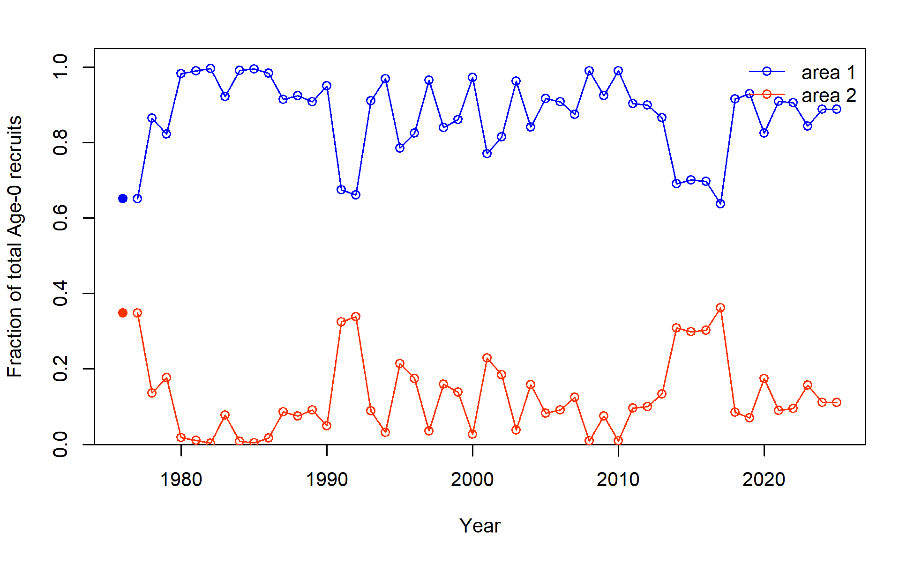
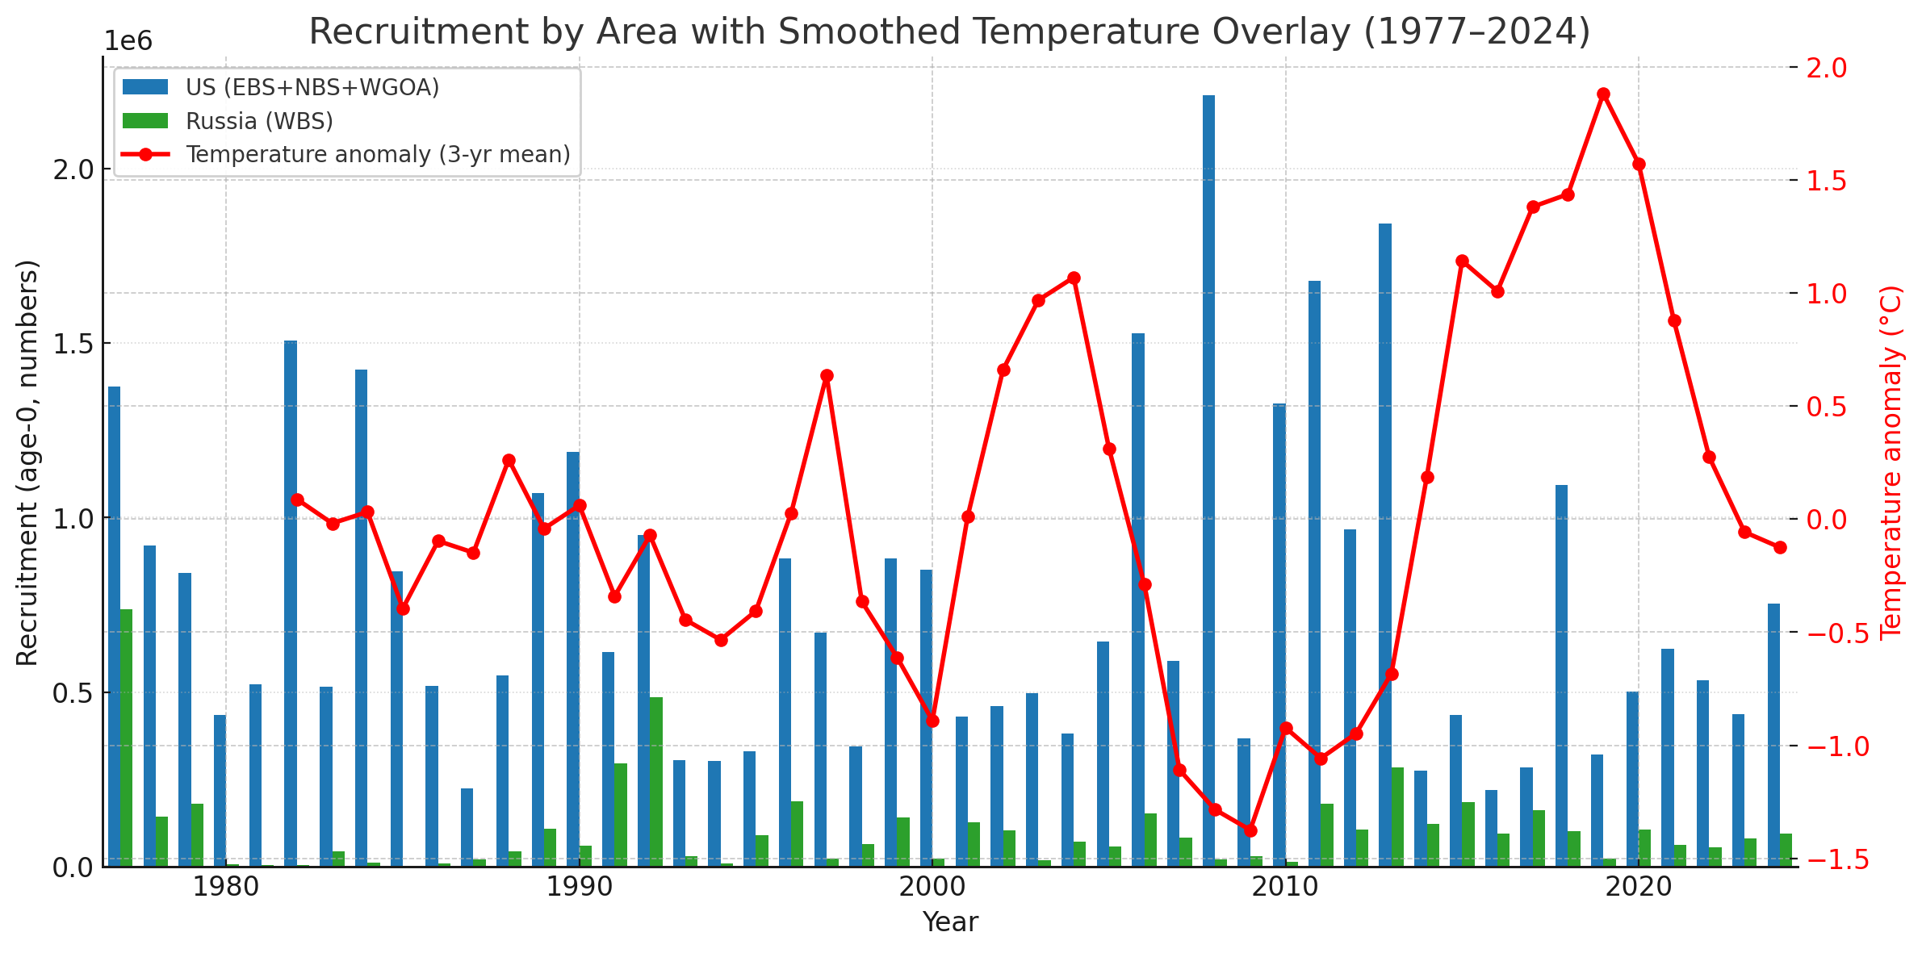
Stock Synthesis Model:
Recruitment
Majority of recruitment estimated originating in U.S. regions
caveat – recruitment proportion is highly uncertain due to lack of age data from WBS
Higher recruitment during cold periods consistent with 2024 stock assessment
These results are preliminary and should not be considered for management purposes

Slide 14
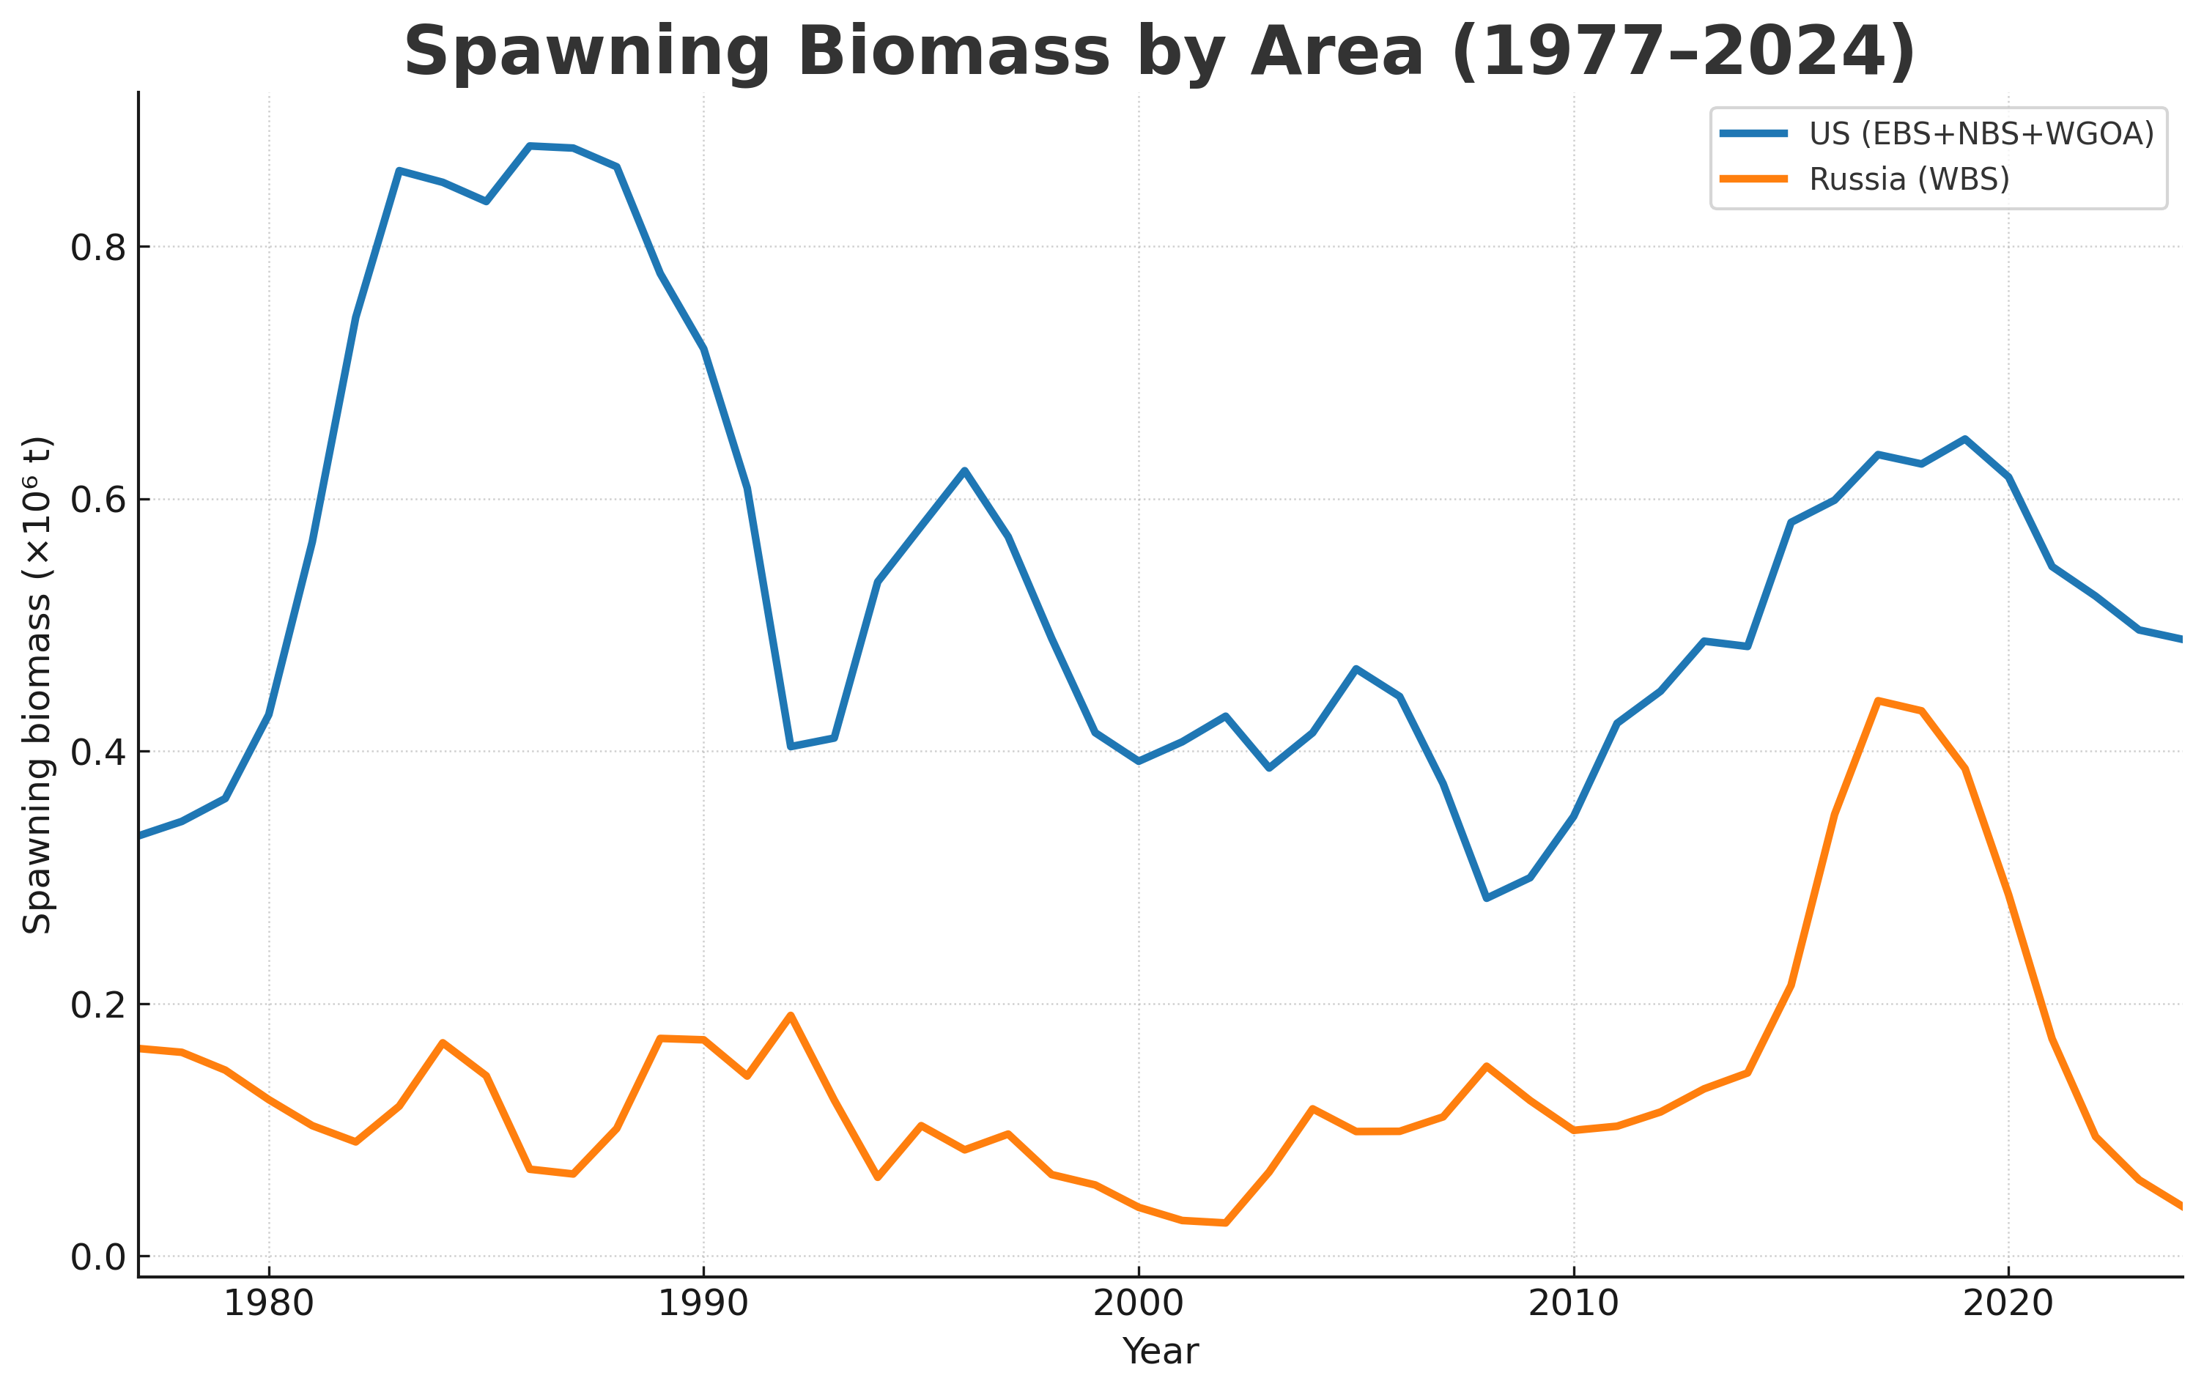
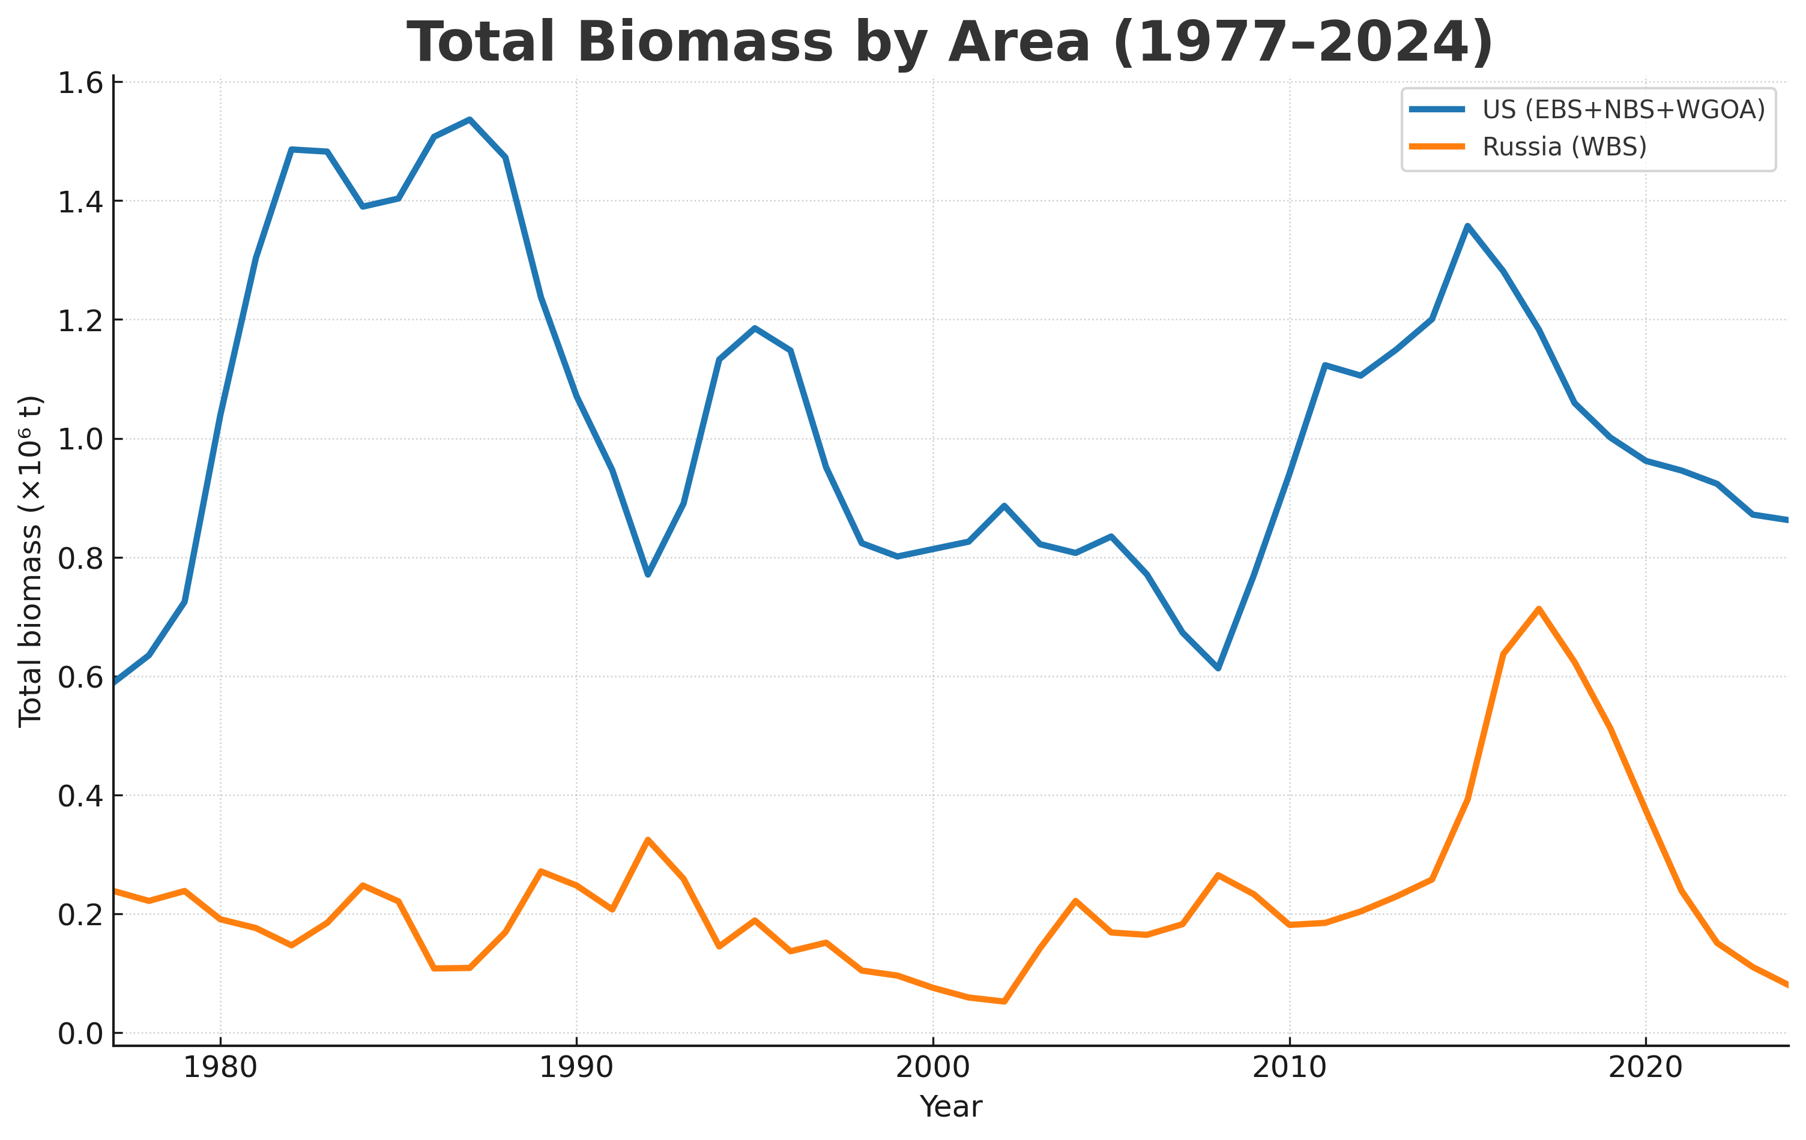
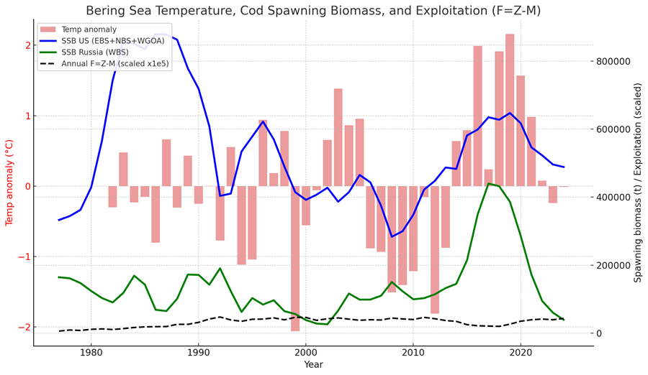
Stock Synthesis Model:
Biomass
Same trend between sdmTMB indices and model estimates for spawning and total biomass
Q = 1.0 for both indices
Higher spawning biomass in warm period followed higher recruitment during cold periods
These results are preliminary and should not be considered for management purposes

Slide 15
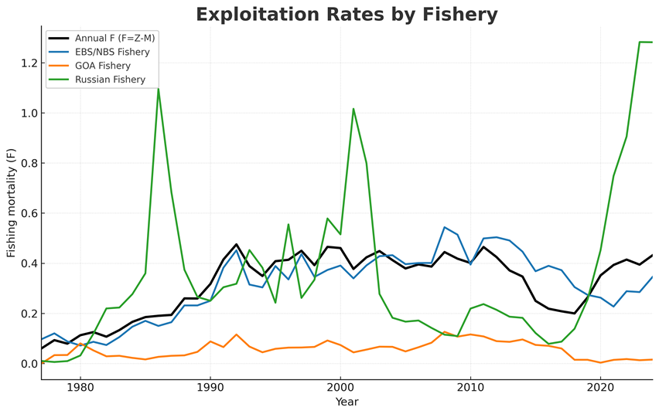
Stock Synthesis Model:
Exploitation
Exploitation rates were stable in U.S. regions under modern management but more variable in the WBS, where catches appear strongly influenced by immigration from U.S. regions.
These results are preliminary and should not be considered for management purposes

Slide 16
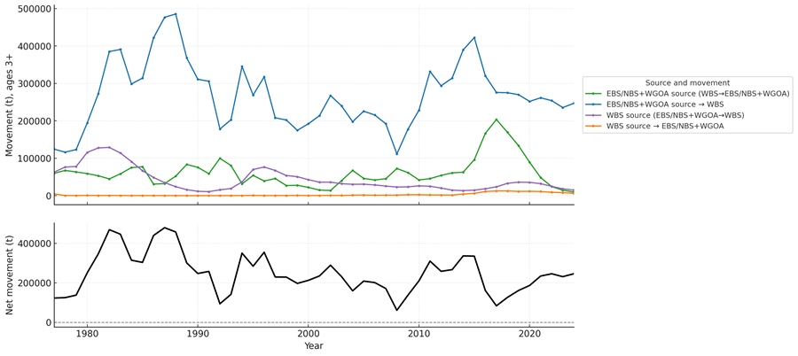
Stock Synthesis Model:
Movement
In this model configuration, with poorly fit growth, U.S. region is a source with the WBS being a sink with the net movement to the WBS from the U.S. zone.
These results are preliminary and should not be considered for management purposes

Slide 17

Modeling Next Steps
General research
Team – Attempt to obtain fishery composition and age data for the western Bering Sea, evaluate alternative assessment modeling platforms (RCEATTLE, SPoRC, RTMB), Genetics research?
Lorenzo Cianelli (OSU) – evaluation of fishery and survey data to ascertain appropriate stock splits for GOA Pacific cod
Krista Oke (UAF) – develop a starvation index for BS and GOA Pacific cod to be use in stock assessment model
Spatial modeling
Stock Synthesis – Steve Barbeaux
Continue development of spatial models
Test sensitivity of two-area model to assumptions on WBS growth
Expand to 3 area model separating wGOA into its own area
SPoRC – Matt Cheng (UAF)
Stochastic Population model over Regional Components: a generalized, spatial, age/sex-structured stock-assessment framework implemented as an R/RTMB package
Create a spatial model for GOA/EBS Pacific cod to explore stock dynamics and environmental forcing of movement and mortality.

